Slide 1




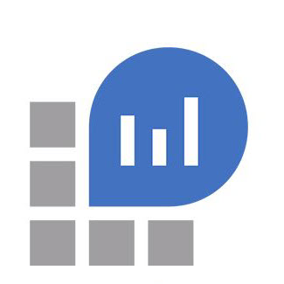
Application Insights and Log Analytics
Azure Function logging

Slide 2
Agenda
Application Insights
Logging with just an instrumentation key
ILogger
Exception bubbles out
Logging with the NuGet package installed
ILogger
Exception bubbles out
TrackTrace
TrackException
Logging with the Serilog Sink for Application Insights
Log Analytics
Logging JSON directly via ILogger
Logging with the Serilog Sink for Log Analytics via ILogger
Forwarding data to a Log Analytics workspace (preview)

Slide 3
Application Insights Logging with only an instrumentation key
If a user logs information in code via the ILogger interface…
What is logged?
Where is it logged?
If an exception bubbles out of the function call…
What is logged?
Where is it logged?
Forwarding data to a Log Analytics workspace (preview)

Slide 4
Application Insights Logging with the NuGet package installed
If a user logs information in code via the ILogger interface…
What is logged?
Where is it logged?
If an exception bubbles out of the function call…
What is logged?
Where is it logged?
If the user uses, TrackTrace or TrackException…
What is logged?
Where is it logged?

Slide 5
Application Insights Logging with the Serilog Sink
If a user logs information in code via the ILogger interface…
What is logged?
Where is it logged?
If an exception bubbles out of the function call…
What is logged?
Where is it logged?

Slide 6
Log Analytics Logging JSON directly via ILogger
Examine the shape of the JSON
Examine how it appears in the custom log

Slide 7
Log Analytics Logging with the Serilog Sink via ILogger
Examine the shape of the JSON
Examine how it appears in the custom log

